Slide 1
Single Family homes in the Shenandoah Valley. Frye St, Waynesboro VA Class 6 1100 Sq.Ft Zip Area 244

Slide 2
Index
1- Title slide
2- Index
3- Mission Statement
4- Roles of the General Contractor
5- Pre-Construction Timeline
6- Project Timeline and Plan
7- Location of Lot
8- Comparable Properties in the Neighborhood
9- Waynesboro Residential Real Estate Data
10- Construction Cost Estimate
11- Costs breakdown of Excavation, Foundation, Rough Hardware, and Carpentry, Insulation and Exterior Finish.
12- Costs breakdown of Exterior Trim, Doors, Windows, Finish Hardware and Carpentry, and (Roofing, Flashing, Fascia)
13- Costs Breakdown of Interior Wall Finish, Painting, Wiring, Lighting Fixtures, Flooring, and Carpeting
14- Costs Breakdown of Bath Accessories, Shower Tub Enclosures, Countertops, Cabinets, and Built-in Appliances.
15- Cost Breakdown of HVAC systems, Plumbing (fixtures & connections) & Sub-total Direct job costs
16- Project Sub Total
17- Grand Total
18- Return on Investment
19- Profit Point Pie
20- Investment Duration

Slide 3
Mission Statement
At Appalockia Homes, our team members believe that building homes is a lifestyle choice that is crafted throughout our lifetimes. We are passionate about Real Estate Development and seek to grow starting from affordable entry level homes to all class levels of homes.
After we have several independent lots constructed and sold under our belt, we have already been discussing and have conceptual work on a 25 acre 52 lot subdivision designed for Class 5&6 homes in Crimora Va, roughly 5 miles north of the lot mentioned in this project package. This pre-planned subdivision was abandoned by the original developer due to the housing bubble crash back in 2007. We feel that it is an opportunistic time to get started on that particular development since the Waynesboro and Augusta county area will continue to grow so heavily from here on out due to leap frog development from Charlottesville and Washington D.C.
To Strive to diversify out retail product locations through-out the Shenandoah Valley and the State of Virginia.
To grow until we have at minimum of one project completion per quarter.
Our upper quality Class 1-3 homes aim to incorporate sustainable energy technologies such as the new cutting edge “Solar Shingles”, microturbine tech and silver LEED certification.

Slide 4
Roles of the General Contractor
Appalockia Homes LLC will work with a selected General Contractor
To assist in the General Contractors duties such as but not limited to.
The General Contractors role and responsibilities include the following
Gathering and Evaluating Bids for Specialty (Sub Contractors).
Interactions with architectural elements such as blueprint selection
Material purchasing and allocation
Coordinating Specialty (sub) contractors to supervise their job.
Assisting the Gen. Contractor in providing Skilled Labor if needed
Overseeing the G.Con in Answering questions and resolve site issues
Oversee the G.Con in Arranging for Permits and Inspections.

Slide 5
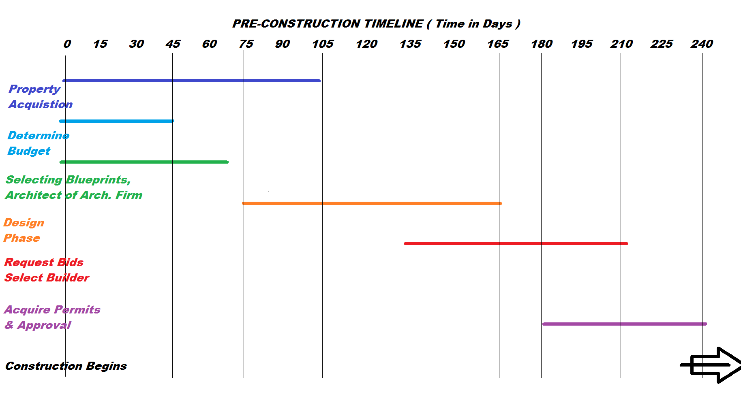
Pre-Construction Timeline

Slide 6
Project Timeline Chart and Plan
Work With the General Contractor to Create a Project Plan during Pre-Construction timeline phase.

Slide 7
Location of Lot

Slide 8
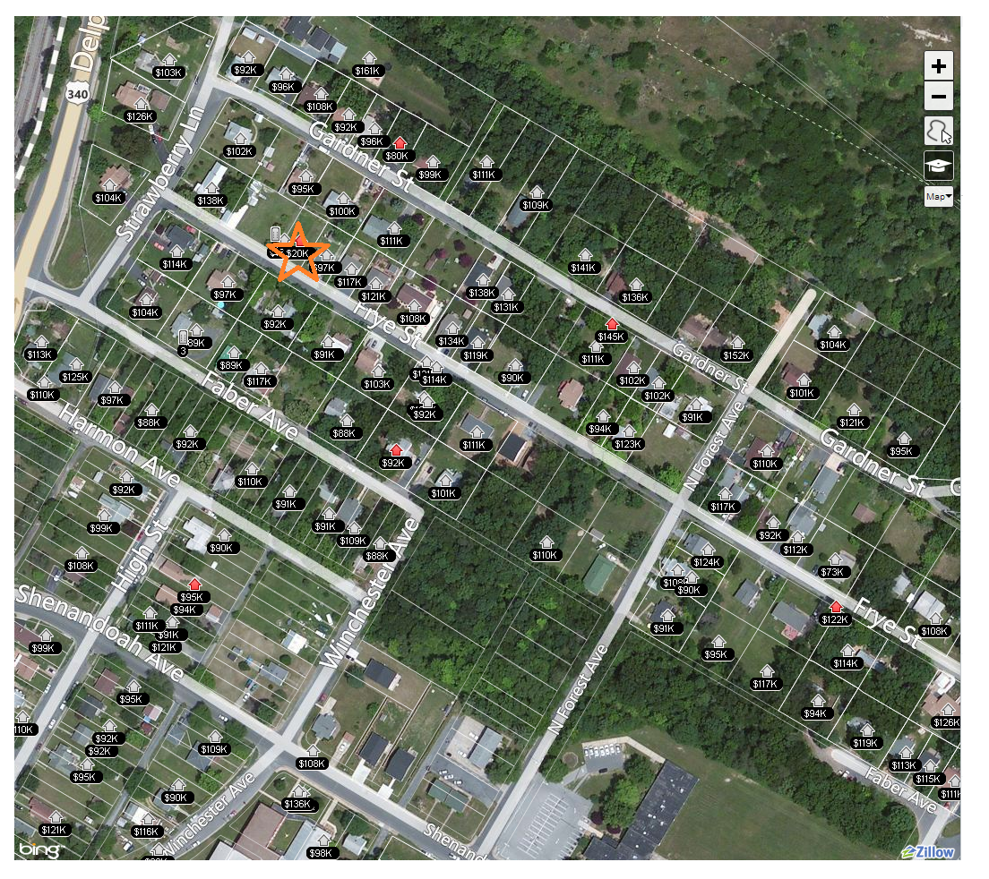

Slide 9
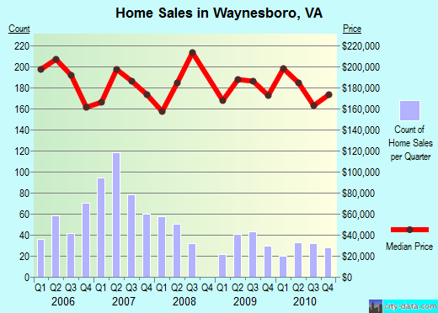
Waynesboro Real Estate Data
Median Listing Price $ 176,750
Median Days on Market 127
363 Active Listings
8.5% Distressed Listings (foreclosures and short sales)
Information from
http://www.realestate.com
/local/market/VA/Waynesboro/

Slide 10
Construction Cost Estimate
This is an estimate for a single family residence built under competitive conditions in or near Staunton, Virginia in December 2013.This estimate includes a foundation as required for normal soil conditions, excavation for foundation and piers on a prepared building pad, floor, wall, interior and exterior finishes, roof cover, interior partitions, doors, windows, trim, electric wiring and fixtures, rough and finish plumbing, built-in appliances, supervision, design fees, permits, utility hook-ups, the contractor's contingency, overhead and profit. Highly decorative, starkly original or exceptionally well-appointed residences will cost more. Add the cost of the land, government-mandated site development fees and the cost of bringing utility lines to the site.

Slide 11
Excavation
Labor $601
Equipment $260
Excavation Total $861
Foundation, Piers, Flatwork
Material $2,116
Labor $2,037
Equipment $529
Foundation, Piers,
Flatwork Total $4,682
Rough Hardware
Material $207
Labor $199
Equipment $52
Rough Hardware Total $458
Rough Carpentry
Material $6,843
Labor $6,182
Rough Carpentry
Total $13,025
Insulation
Material $1,281
Labor $536
Insulation Total $1,817
Exterior Finish
Material $3,938
Labor $1,405
Equipment $274
Exterior Finish Total $5,617

Slide 12
Exterior Trim
Material $247
Labor $238
Equipment $62
Exterior Trim Total $547
Doors
Material $625
Labor $321
Doors Total $946
Windows
Material $1,077
Labor $448
Windows Total $1,525
Finish Hardware
Material $104
Labor $54
Finish Hardware Total $158
Roofing, Flashing, Fascia
Material $2,861
Labor $1,469
Roofing, Flashing, Fascia Total $4,330
Finish Carpentry
Material $380
Labor $1,171
Finish Carpentry Total $1,551

Slide 13
Interior Wall Finish
Material $1,823
Labor $1,723
Interior Wall Finish
Total $3,546
Painting
Material $1,089
Labor $1,556
Painting Total $2,645
Wiring
Material $1,106
Labor $1,278
Wiring Total $2,384
Lighting Fixtures
Material $829
Labor $160
Lighting Fixtures
Total $989
Flooring
Material $814
Labor $707
Flooring Total $1,521
Carpeting
Material $1,621
Labor $354
Carpeting Total $1,975

Slide 14
Bath Accessories
Material $401
Labor $151
Bath Accessories
Total $552
Shower & Tub Enclosure
Material $256
Labor $132
Shower & Tub Enclosure
Total $388
Countertops
Material $775
Labor $398
Countertops Total $1,173
Cabinets
Material $2,548
Labor $490
Cabinets Total $3,038
Built In Appliances
Material $1,240
Labor $106
Built In Appliances
Total $1,346

Slide 15
Plumbing Fixtures
Material $2,364
Labor $458
Plumbing Fixtures
Total $2,822
Heating and Cooling Systems
Material $3,159
Labor $4,739
Heating and Cooling Systems Total $7,898
Plumbing Rough-in and Connection
Material $1,164
Labor $1,729
Equipment $171
Plumbing Rough-in
and Connection
Total $3,064
Subtotal Direct Job Costs
Material $38,868
Labor $28,642
Equipment $1,348
Subtotal Direct Job Costs
Total $68,858

Slide 16
Indirect Job Costs
Final Cleanup Total $347
Insurance Total $2,432
Permits & Utilities Total $1,476
Plans & Specs Total $347
Subtotal Indirect Job Costs
Material $4,255
Labor $347
Indirect Job Costs Total $4,602
Contractor Markup Total $10,856

Slide 17
Total Cost
Material $53,979
Labor $28,989
Equipment $1,348
Before Land Total $84,316
Lot Listed for $19,900
Grand Total $ 104,216

Slide 18
Return of Investment
Project Grand Total = $ 104,216
Capital Requested = $ 110,000
Home Listing = $ 165,000
Negotiation Cushion, Sales Costs, and Closing Cost @ 10% = $16,500
After Close = $ 148,500
Investors project capital returned = $110,00
Remainder after capital = $38,500
ROI allocated 4 ways = $9,625
ROI = 8.75% for Angel Investor

Slide 19
Pay out after Investment Return and costs of sales and tax

Slide 20
Investment Duration
Targeted sales within 90 days (1 quarter) of construction completion.
Area wide median listing duration is 127 Days or about 4 months and 1 Week.
Total project time estimated between 8 Months to a Year. A complete breakdown of project time will be completed in conjunction with the General contractors schedule under Project timeline and Chart Plan
Targeted Pre-construction Start Date sooner then but at least by 07/01/2014 with estimated completion and move-sales ready by 4/27/2015
Average listing duration on market is 127 plus completion date of 4/27/2015 equals 9/01/2015

